Slide 1

Facies Exercise:
Carboniferous Palaeoenvironments
Notes:
Stethacanthus 10 Bizarre Beasts That Roamed the Carboniferous Waters – Owlcation
Stethacanthus was a cartilaginous fish that resembled a shark in appearance. It lived from the late Devonian Period to the late Carboniferous Period (383 to 299 million years ago). Fossils of this animal have been found in Asia, Russia, North America, and Europe.
Stethacanthus typically grew around 70 centimeters (2.3 feet) in length and is best known for its bizarre anvil-shaped dorsal fin, which has only been identified in males. Small dermal spikes covered the top of the dorsal fin and animal's head. The purpose of this large dorsal fin is still unknown. It may have played a role in attracting females or possibly was used during the mating process. It also may have been used to deter potential predators.
Researchers believe Stethacanthus was a slow swimmer, as its over-sized dorsal fin likely prevented it from being able to reach high speeds in the water. Its teeth were fairly small in comparison to other predatory fish of the period, meaning that it may have been a bottom-dweller that fed on crustaceans and smaller bottom-feeding fish.

Slide 2
Your task
You are provided with some cored intervals from a borehole drilled through some Westphalian-C (Carboniferous) rocks
A range of facies types are present.
Draw a schematic log through one (or more) of the three sections of core.
Devise a facies scheme to adequately capture the variability within the cores
Describe the facies based on the key component of facies, i.e., Grain type and composition; Grain size; Sedimentary structures; Colour; Biological structures and content e.g. traces fossils, body fossils.
You will be provided with a hand lens and grain size card
The cored interval is Westphalian C/D in age. The specific interval is the Ketch Member of the Schooner Formation which traditionally is part of the ‘Barren Red Measures’ and overlies the Coal Measures.

Slide 3
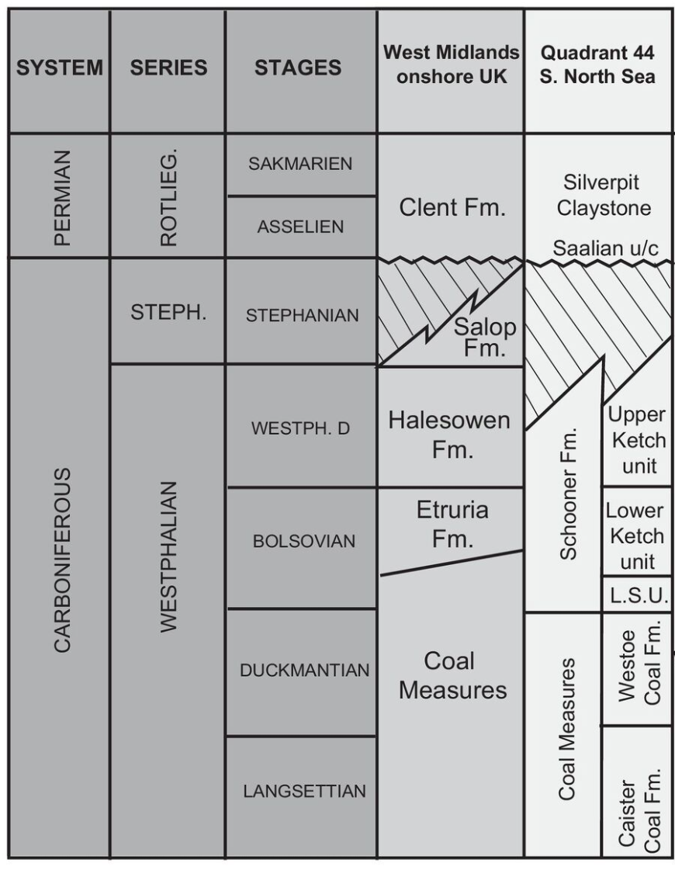
Well 44/21-4
Ketch unit (or member) is broadly equivalent to the ‘Barren Red Measures’

Slide 4
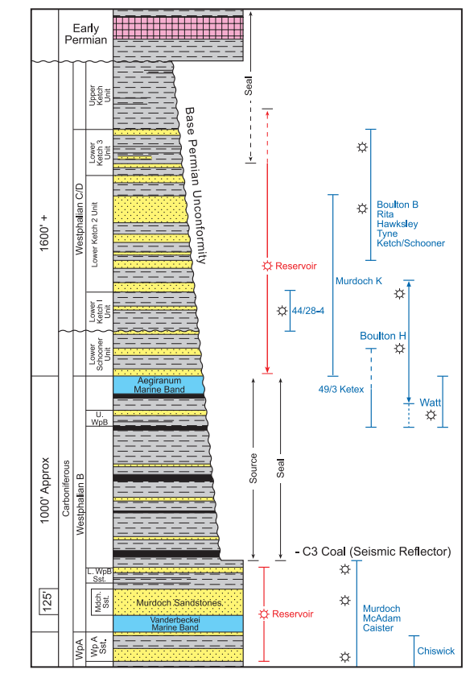
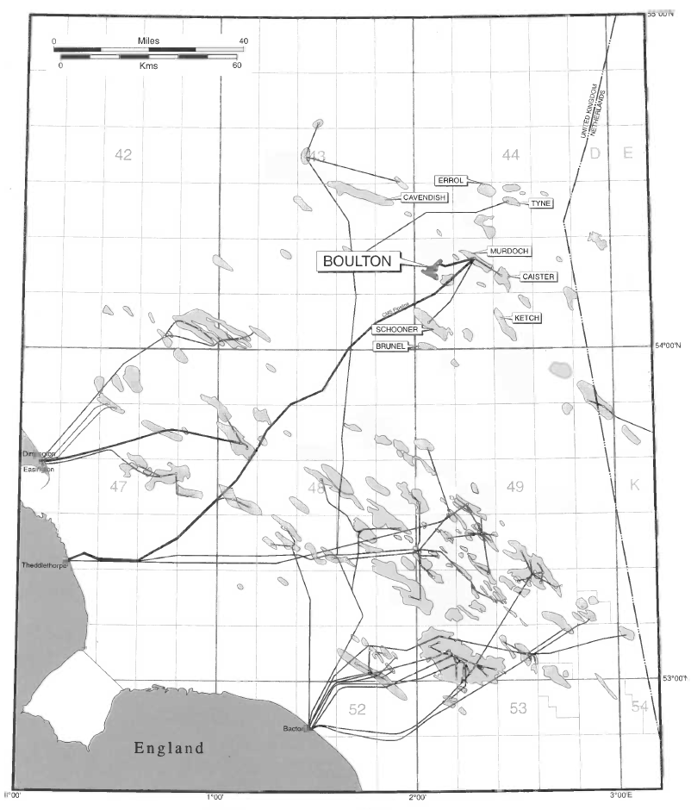
Boulton Field, Well 44/21-4
(Quadrant 44, North Sea, Block 21, Well 4.). Drilled in 1988 by Conoco Phillips and partners, the well successfully tested gas in the Westphalian C/D at a rate of 33.0 MMSCFD.
Well 44/21-4
Conway and Valvatne. 2003. Full ref in ppt notes below
Cooper et al. 2005. Full ref in ppt notes below
Notes:
MMSCFD: Million standard cubic feet per day
Conway, A.M. and Valvatne, C. 2003. The Boulton Field, Block 44/21a, UK North Sea. In: GLUYAS, J. G. & HICttENS, H. M. (eds) 2003. United Kingdom Oil and Gas Fields, Commemorative Millennium Volume. Geological Society, London, Memoir, 20, 671-680.
COOPER, M. M., EASTON, S. D. W., LYNCH, J. J. & FOZDAR, I. M. 2005. The Caister–Murdoch System (CMS) III Carboniferous cluster development, UK Southern North Sea. In: DORE, A. G. & VINING, B. A. (eds) Petroleum Geology: North-West Europe and Global Perspectives—Proceedings of the 6th Petroleum Geology Conference, 317–326.

Slide 5
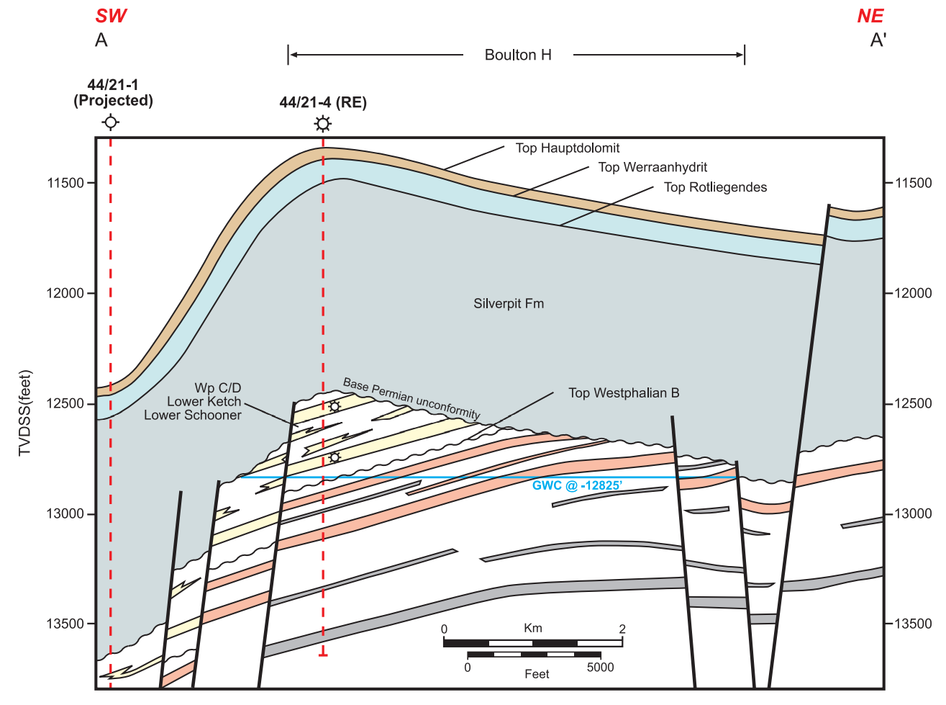
Well 44/21-4
Cooper et al. 2005.

Slide 6
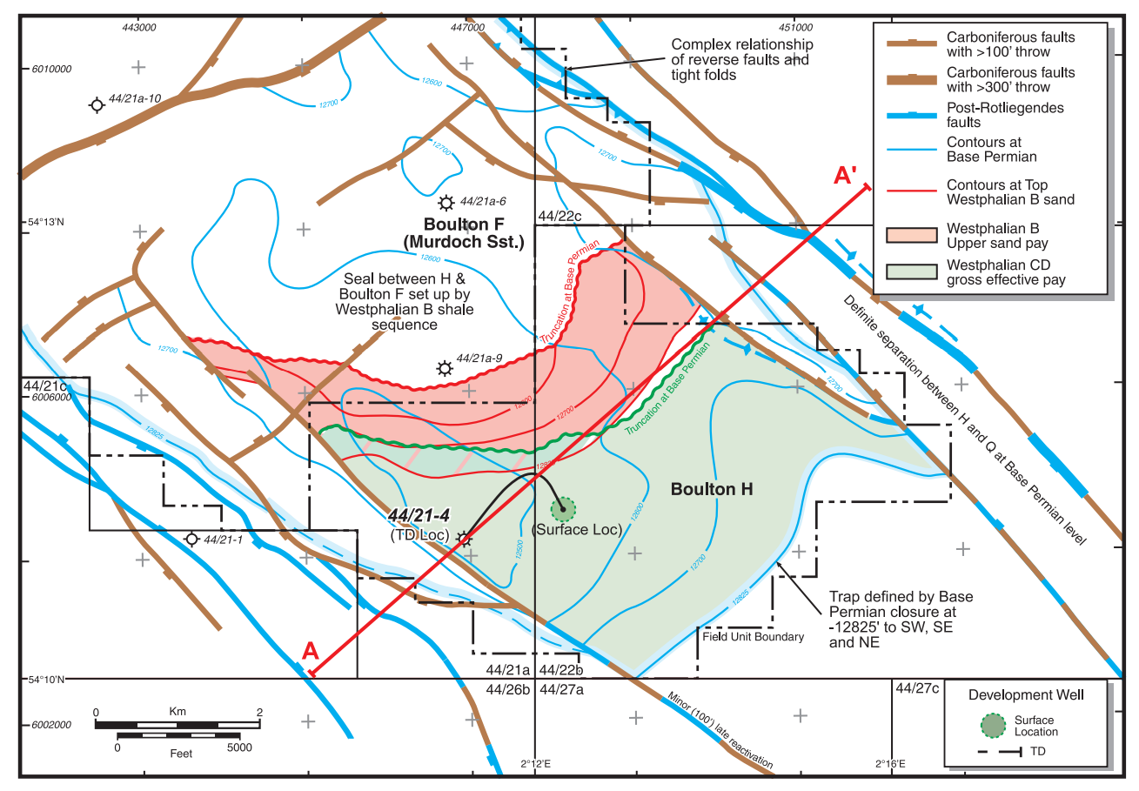
Cooper et al. 2005.

Slide 7
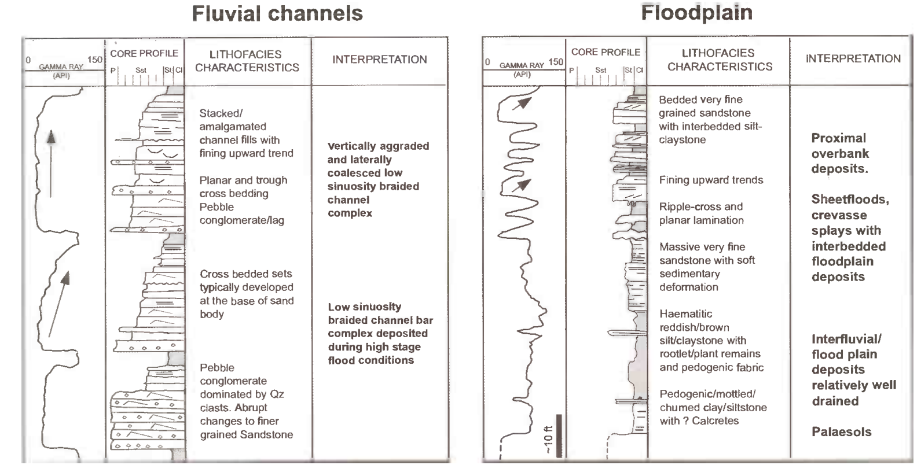
Lithofacies scheme for the ‘Barren Red Measures’
Moscariello (2003).
Scale: 10 feet = 3 metres
Moscariello (2003).

Slide 8
Official definition: British Geological Survey (BGS):
The Ketch Member (Schooner Formation) is composed of reddish brown to purple mudstones and silty mudstones, and grey, reddish-brown, or occasionally white, fine to coarse grained, sometimes pebbly sandstones. The sandstone beds occur as single and stacked channel-fill units that are mostly less than 10 m, but are exceptionally up to 20 m thick. Such sandstones are respectively associated with blocky and complex gamma-log profiles, and they constitute up to 40 per cent of the member. They are moderately or poorly sorted, and variably micaceous. Where the sandstones are pebbly, intraformational clasts of red mudstone are common, but the predominant clast type comprises well rounded quartzite, presumably derived from Caledonian massif sources. The sandstones are cemented mainly by silica and hematite, but halite and anhydrite cements have been reported locally near the top of the member. Red mudstones and siltstones occur in units that are mostly less than 40 m thick. In cores, such units are seen to include mature palaeosols, each comprising a grey, leached upper zone overlying red and grey, vertically veined and mottled beds. Units of interlaminated fine-grained sandstone and mudstone also occur and are associated with ratty gamma-log profiles. The mudstones contain root systems, oxidized remains of plant fragments, and hematite concretions that replaced early diagenetic siderite (Besly et al. 1993). Desiccation cracks occur towards the top of the red-bed section in well 44/28-1. Besly et al. (1993) reported grey, coal-bearing intercalations and prominent caliche horizons near the top of the primary red beds in well 44/21-3. Sandstone bed thickness is significantly reduced in the coal-bearing section, and gamma-ray response of the mudstones is higher than in the underlying red beds. This lithofacies is absent from other wells in the Silver Pit area, presumably due to pre-Permian erosion.
Lower Ketch belongs to ‘Barren Red Measures Group’ according to Moscariello (2003).
Notes:
Moscariello, A. 2003. The Schooner Field, Blocks 44/26a, 43/30a, UK North Sea. Geological Society, London, Memoirs, 20, 811-824, 1 January 2003, https://doi.org/10.1144/GSL.MEM.2003.020.01.68

Slide 9
From Besley et al. 1993
UK Quadrant 44 A red bed sequence up to 350 m thick overlies Coal Measures of Westphalian B or early Westphalian C age (NJ zone). In Well 44/21-3 the uppermost part of the red bed sequence is lithostratigraphically distinctive and contains grey coal-bearing intercalations with a well established late Westphalian C palynoflora (upper part of SL zone). It is clear from log correlation between this and other wells (Fig. 4) that most of the red bed sequence encountered in wells in the UK sector is of Westphalian C age.
Sedimentology: Extensive cores of the Westphalian C red bed sequence in 44/ 28-1 show the sediments to be dominantly fluvial, containing single and multi-storey braided channel deposits (Figs 7a and b), interbedded with intensely rooted overbank deposits that locally contain ferruginous palaeosols (Fig 7c; cf. Besly and Fielding 1989). However, in some parts of the succession the association of facies is strongly reminiscent of the waterlogged alluvial plain facies typically encountered in the underlying Coal Measures (Fig. 7d). This association includes interlaminated fine-grained sandstones and mudstones, showing ripple cross-lamination and varying degrees of bioturbation. The presence of lepidophyte root systems, oxidized remains of plant fragments and haematite concretions that replace early
Notes:
Besley, B.M., Burley, S.D., and Turner, P. 1993. The late Carboniferous 'Barren Red Bed' play of the Silver Pit area, Southern North Sea. Petroleum Geology of Northwest Europe: Proceedings of the 4th Conference (edited by J. R. Parker). © 1993 Petroleum Geology '86 Ltd. Published by The Geological Society, London, pp. 727-740.

Slide 10
